Slide 1
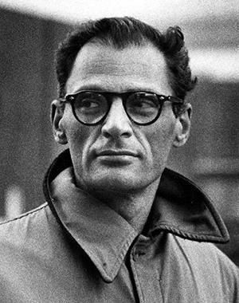
Author: Miller
Instructions | Title
What is Miller’s full name? | Arthur Asher Miller
Link (Cite Your Source): | https://arthurmillersociety.net/am-chronology/
Where was he born? | Insert text
Link (Cite Your Source): | Insert link
In what year was he born? | Insert text
Link (Cite Your Source): | Insert link
When did he die? | Insert text
Link (Cite Your Source): | Insert link

Slide 2
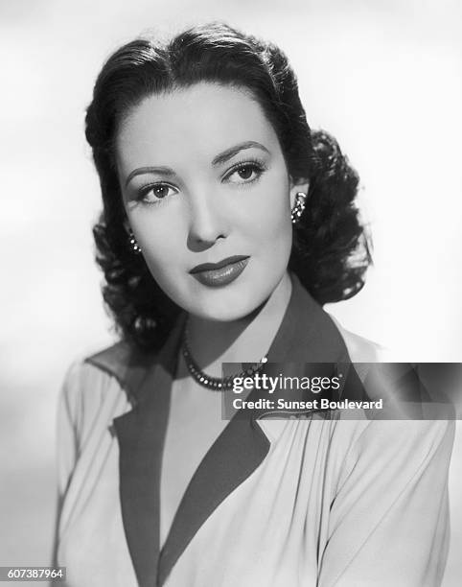
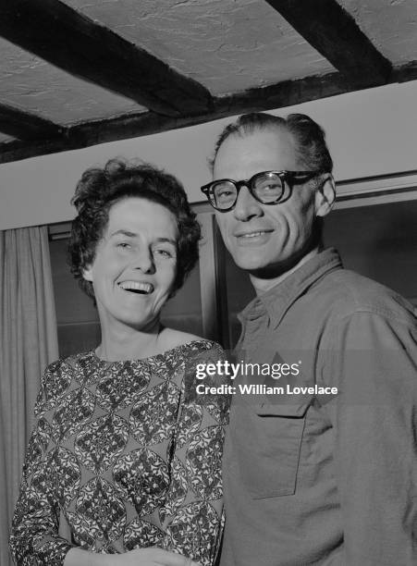

Author: Miller
Instructions | Title
Arthur Miller was married three times in his lifetime. Record the name of his second wife, and include an image of her.
Mary Slattery
_____________
Inge Morath
(1940–1956)
(1956–1961)
(1962–2002)

Slide 3

Context: McCarthyism
Instructions | Title
Who was Senator Joseph McCarthy, and what role did he play in the Red Scare of the 1950s? | Insert text
Link (Cite Your Source): | Insert link
What public accusation did McCarthy make against people in government and society? | Insert text
Link (Cite Your Source): | Insert link

Slide 4
Context: McCarthyism
Instructions | Title
What was the House Un-American Activities Committee (HUAC)? | Insert text
Link (Cite Your Source): | Insert link
Why was Miller brought before the House of Un-American Activities Committee? | Insert text
Link (Cite Your Source): | Insert link

Slide 5
Context: McCarthyism
Instructions | Title
Which two groups of people (w______ and e___________) were often labeled as Communist sympathizers, making it difficult for them to continue working? | W______ and e___________ were often labeled as Communist sympathizers.
Link (Cite Your Source): | Insert link
Name three artists or performers who were singled out during McCarthyism as Communists or Communist sympathizers. | Insert text
Link (Cite Your Source): | Insert link

Slide 6
Context: McCarthyism
Instructions | Title
What happened to Senator Joseph McCarthy in 1954 that reduced his power and influence? | Insert text
Link (Cite Your Source): | Insert link

Slide 7

Context: Puritan Life & Salem Village
Instructions | Title
What was daily life like for Puritan children in 17th-century New England? | Insert text
Link (Cite Your Source): | Insert link
According to Puritan beliefs, who had a more difficult life, girls or boys, and why? | Insert text
Link (Cite Your Source): | Insert link
What was the title of the book by Cotton Mather that helped incite fears of witchcraft in New England? | Insert text
Link (Cite Your Source): | Insert link

Slide 8
Context: Puritan Life & Salem Village
Instructions | Title
What divisions or conflicts existed within Salem Village before the witch trials began? | Insert text
Link (Cite Your Source): | Insert link
Why was the hiring of Reverend Samuel Parris significant for Salem Village? | Insert text
Link (Cite Your Source): | Insert link
What did the Puritans believe about the Devil’s existence and influence in daily life? | Insert text
Link (Cite Your Source): | Insert link

Slide 9
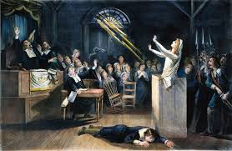
Context: Salem Witch Trials
Instructions | Title
Who was known as the “Man of Iron,” and how did he receive this nickname? | Insert text
Link (Cite Your Source): | Insert link
On what four dates did public hangings take place during the Salem witch trials? | Insert text
Link (Cite Your Source): | Insert link

Slide 10
Context: Salem Witch Trials
Instructions | Title
What choices or options were available to people accused of witchcraft, and what were the risks or benefits of one of those options? | Insert text
Link (Cite Your Source): | Insert link
What were “witches’ marks,” and how were they used as evidence in the trials? | Insert text
Link (Cite Your Source): | Insert link
What were two main reasons the hysteria came to an end in Salem? | Insert text
Link (Cite Your Source): | Insert link

Slide 11
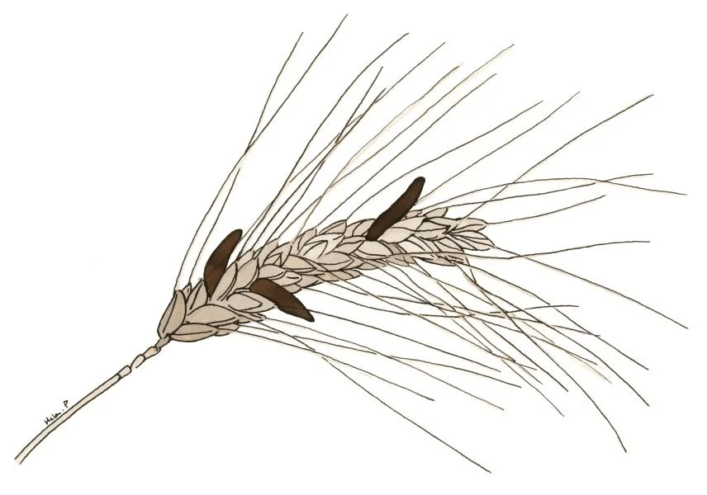
Context: Ergot Theory
Instructions | Title
What is ergot, and how can it contaminate rye or grain? | Insert text
Link (Cite Your Source): | Insert link
How does the ergot poisoning theory attempt to explain the Salem witch trials? | Insert text
Link (Cite Your Source): | Insert link
What types of behaviors were displayed by the afflicted girls during the Salem witch trials? | Insert text
Link (Cite Your Source): | Insert link

Slide 12
Context: Ergot Theory
Instructions | Title
What are the physical and psychological side effects of ergot poisoning? | Insert text
Link (Cite Your Source): | Insert link
Who first suggested a connection between ergotism and the Salem witch trials? | Insert text
Link (Cite Your Source): | Insert link
In what decade was the ergot theory first proposed? | Insert text
Link (Cite Your Source): | Insert link

Slide 13
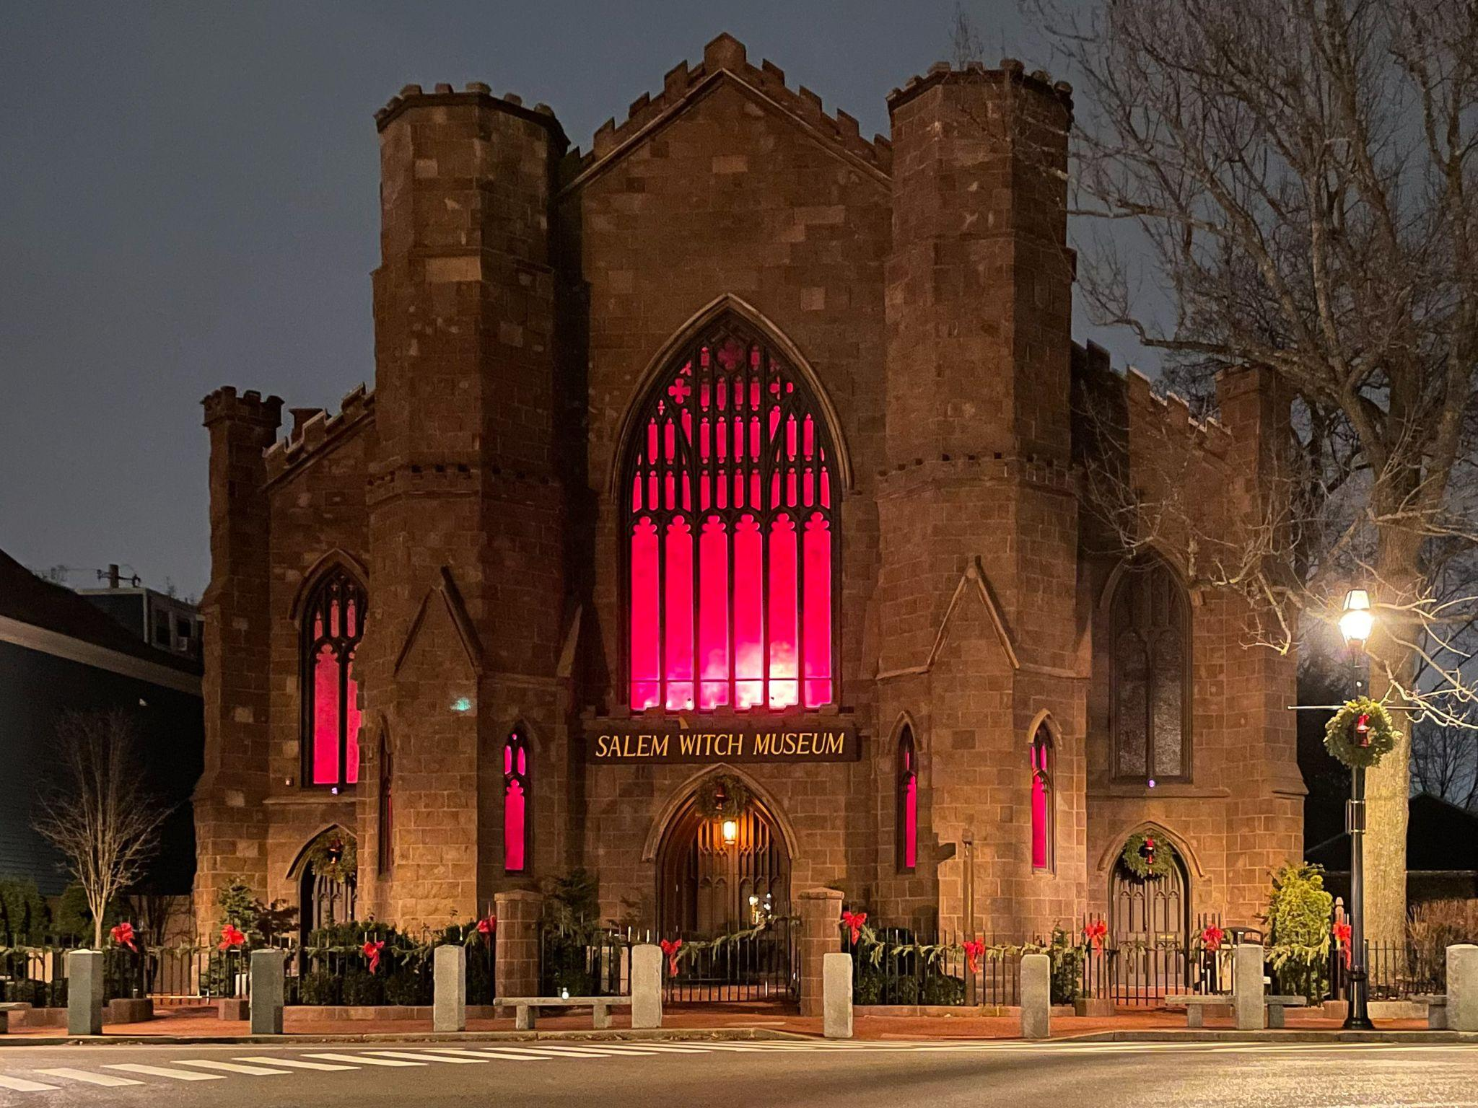
Context: Salem Witch Museum
Instructions | Title
The daughter and niece of whom became sick in 1692? | Insert text
Link (Cite Your Source): | https://salemwitchmuseum.com/my-account/history-education/
How many people died because of the Salem witch trials? | __ women and __ men were hanged, __ man was tortured to death, and at least __ people perished in prison.
Link (Cite Your Source): | https://salemwitchmuseum.com/my-account/history-education/
Salem Witch Museum

Slide 14
Context: Salem Witch Museum
Instructions | Title
What four factors “created a fertile ground for fear and suspicion” in the Massachusetts Bay Colony, according to the article? | The four factors are __________, __________, __________, and __________.
Link (Cite Your Source): | https://salemwitchmuseum.com/my-account/history-education/
A “belief in the power of the accused to use their invisible shapes or spectres to torture their victims” is known as what type of evidence? | Insert text
Link (Cite Your Source): | https://salemwitchmuseum.com/my-account/history-education/
Salem Witch Museum

Slide 15
The Crucible
Webquest
Miller, McCarthyism, and Massachusetts

Slide 16
INSTRUCTIONS
Search (using Google or another search engine) for the answer to each question;
Choose answers only from reliable, academic sources (such as universities, government websites, museums, libraries, or established organizations); and
Do not use Wikipedia, AI-generated content, or informal blogs.
Record your answer in the table. Write it in your own words (do not copy/paste full sentences);
Copy the web address (URL) from the address bar (CTRL+C).
Paste the web address into the cell next to “Link (Cite Your Source)” using CTRL+SHIFT+V (to paste without formatting).

